Slide 1
Lab3

Slide 2
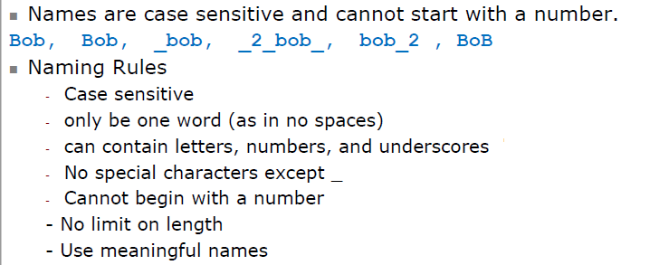
Naming Rules

Slide 3
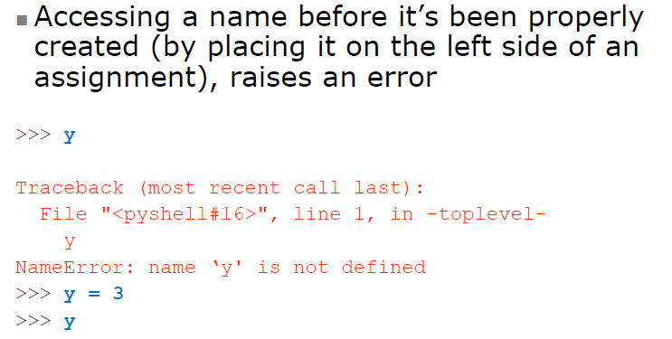
Accessing Non-Existent Name

Slide 4
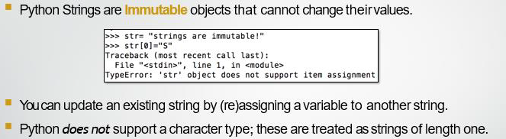
Strings

Slide 5
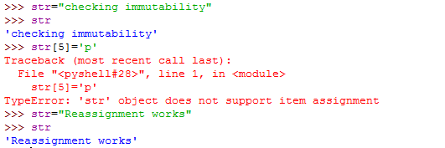
Strings
Strings are immutable in Python. This means that elements of a string cannot be changed once it has been assigned.
We can simply reassign different strings to the same name.

Slide 6
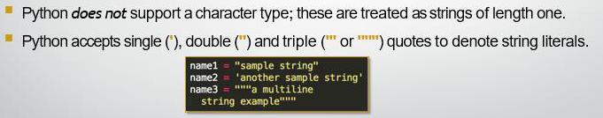

Strings

Slide 7
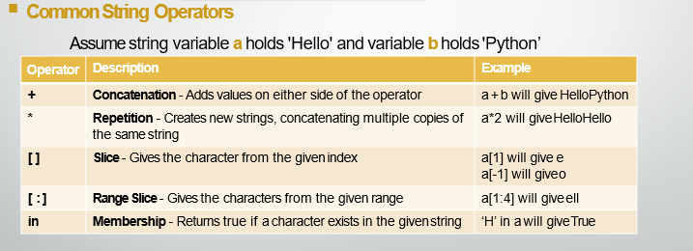
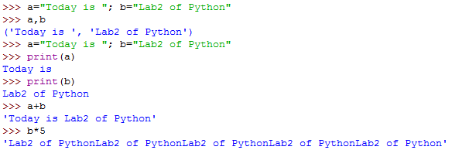
Common String Operations

Slide 8

Common String Operations

Slide 9
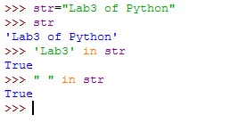
Common String Operations

Slide 10
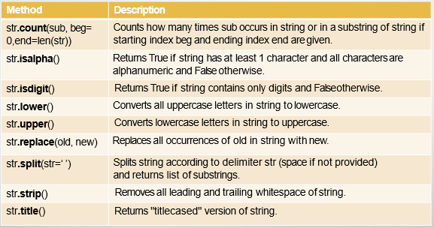

Common String Operations

Slide 11
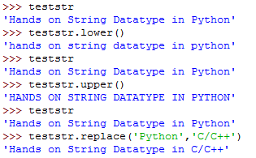
Common String Operations
Handson
The original string does not change on using upper and lower functions

Slide 12

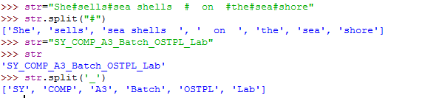
Common String Operations
The split() method splits a string into a list.
You can specify the separator, default separator is any whitespace.

Slide 13
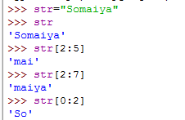
Common String Operations
String Slicing-
You can return a range of characters by using the slice syntax.
Specify the start index and the end index, separated by a colon, to return a part of the string.
Examples:
S | o | m | a | I | y | a
0 | 1 | 2 | 3 | 4 | 5 | 6

Slide 14


Common String Operations
String Slicing-
Starts printing from index=first operand to index=one less than second operand
str[0:4]= prints from index 0 to index 3
Even if the last index is outside bound, does not raise error and prints whole string
S | o | m | a | I | y | a
0 | 1 | 2 | 3 | 4 | 5 | 6

Slide 15


Common String Operations
String Slicing-
If the first operand is omitted, the range starts at zero index.
If the second operand is omitted, the range goes up to the end of tuple
You can omit the first or last index
Examples:
S | o | m | a | I | y | a
0 | 1 | 2 | 3 | 4 | 5 | 6

Slide 16


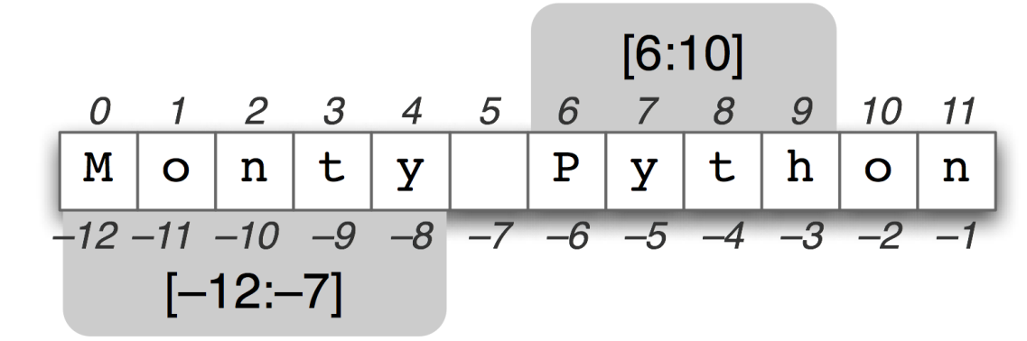

Common String Operations
String Slicing-
Negative slicing
S | o | m | a | I | y | a
-7 | -6 | -5 | -4 | -3 | -2 | -1

Slide 17

Write a python program to calculate distance between two points taking input from the user
Distance can be calculated using the two points (x₁, y₁) and (x₂, y₂), the distance d between these points is given by the formula:
for e.g : let x_{1 ,} y₁=10,9 and x₂ , y₂=4,1
then (x₂-x₁)²=(10-4)² = 6² = 36
and (y₂-y₁)²= (9-1)² = 8² = 64
now 64 + 36 =100 and
100 is square root of 10
so distance between (10,9) and (4,1) is 10 .

Slide 18
Conditional statements
In Python, True and False are Boolean objects of class 'bool' and they are immutable.
Python assumes any non-zero and non-null values as True, otherwise it is False value.
Python does not provide switch or case statements as in other languages.

Slide 19
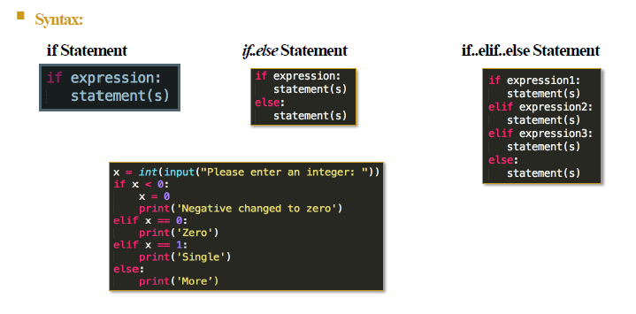
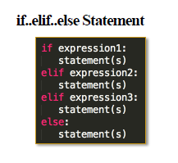
Conditional statements

Slide 20
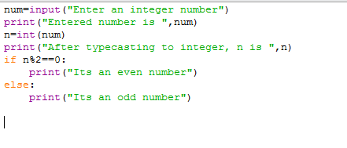
Program to find out whether a number is even or odd
Pgm

Slide 21
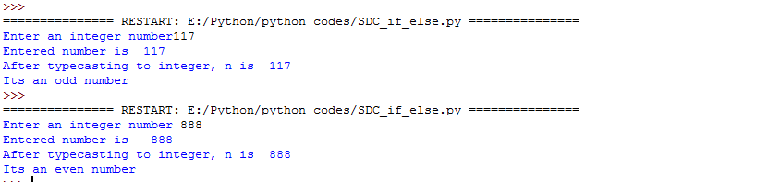
Program to find out whether a number is even or odd
Output

Slide 22
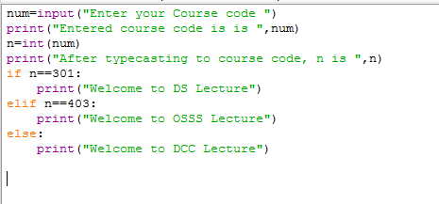
Program for if-elif-else
Pgm

Slide 23
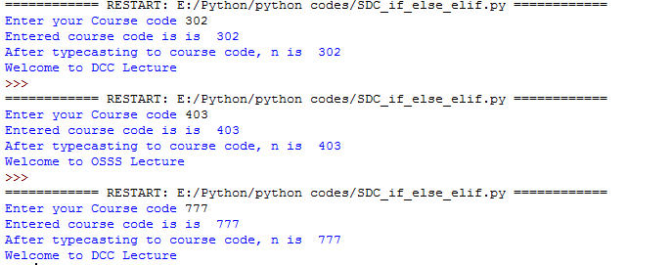
Program for if-elif-else
Output

